Slide 1
vpython 期末作業
-模擬蒸氣槽推動carnot refrigerator
組員:林予康
陳映樵
蘇磐洋

Slide 2
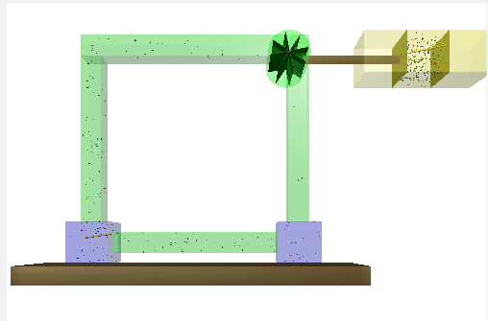
2
3
1

Slide 3
stage3
stage4
stage2
stage6
stage1
stage5

Slide 4
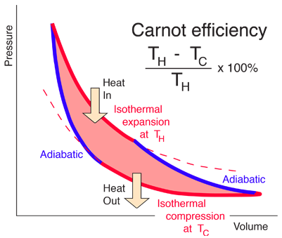
carnot engine(和前頁stage不同)
stage 3
stage 1
stage 2
stage 0

Slide 5
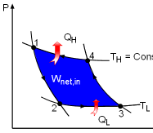
carnot refiegerator(和前頁stage不同)
stage3
stage 0 stage 2
stage 1

Slide 6
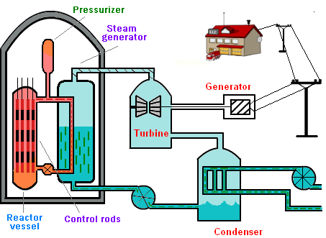
turbine generator
rise temperature
container1
lower temperature
container2

